Slide 1
Basic Unix Commands

Slide 2
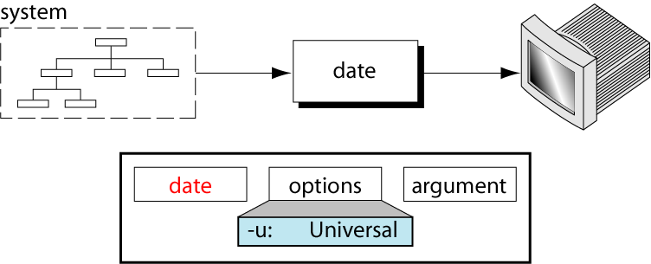
The date Command

Slide 3
date command is helpful to display date in several formats. It also allows you to set systems date and time.
When you execute date command without any option, it will display the current date and time as shown below.
date
Mon May 20 22:02:24 PDT 2013

Slide 4
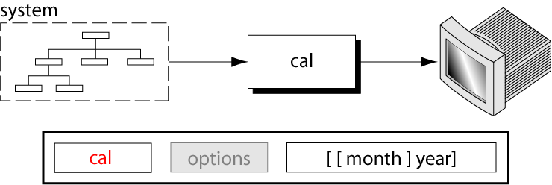
The calendar Command

Slide 5
cal displays a simple calendar. If arguments are not specified, the current month is displayed.
The options are as follows:
-1 Display single month output. (This is the default.)
-3 Display prev/current/next month output.
-s Display Sunday as the first day of the week.

Slide 6
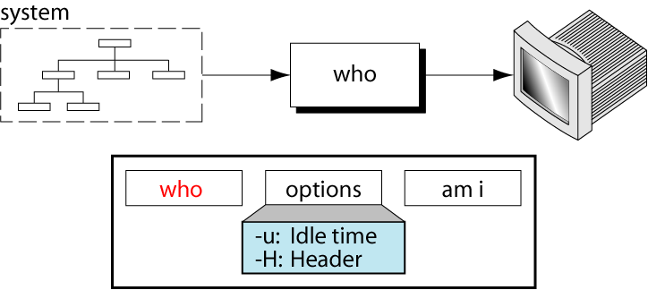
The who Command

Slide 7
who command shows who is logged on to the system. This is a useful command for a Linux system administrator because they can check how many users currently logged in the system and who they are.
who
root tty1 2009-07-06 22:06
luzar tty7 2009-07-06 19:17 (:0)
luzar pts/0 2009-07-06 21:28 (:0.0)

Slide 8
who am i from a Linux command line terminal (and unix as well), the who command prints only the information about user who runs the command.
who am i
luzar pts/0 2009-07-06 22:39 (:0.0)

Slide 9
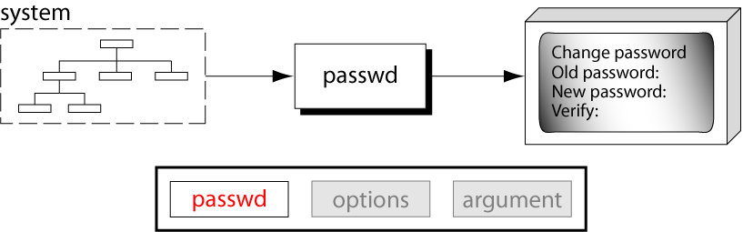
The passwd Command

Slide 10
The passwd command changes passwords for user accounts. A normal user may only change the password for his/her own account, while the superuser may change the password for any account.passwd also changes the account or associated password validity period.
sudo passwd coolcoder
Changing password for coolcoder.
(current) UNIX password:
Enter new UNIX password:
Retype new UNIX password:
passwd: password updated successfully

Slide 11
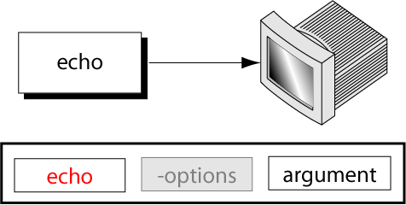
The echo Command

Slide 12
echo command prints the given input string to standard output.
echo "hello India“
The above command will print as hello India

Slide 13
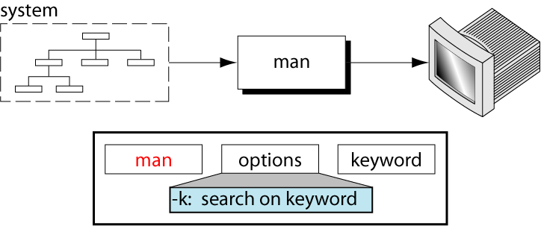
The man Command

Slide 14
In UNIX and Linux distros, command line programs come with their own documentation called manual pages or man pages.
To read the man page of an UNIX command, pass the command name as the argument to the man.
The following will display the man page for passwd command.
man passwd
PASSWD(1) User Commands PASSWD(1)
NAME
      passwd - change user password
      ...

Slide 15
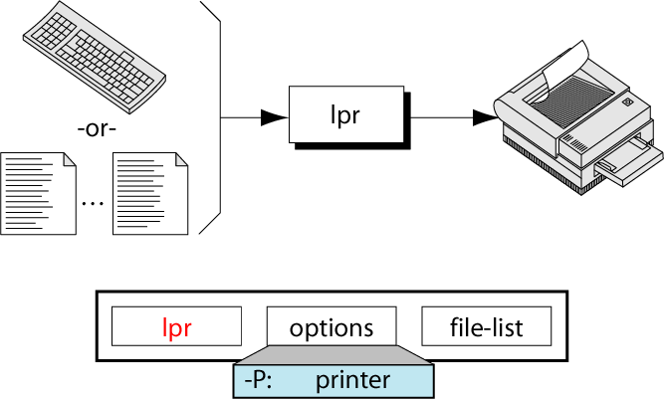
The lpr Command

Slide 16
lpr submits files for printing. Files named on the command line are sent to the named printer (or the system default destination if no destination is specified). If no files are listed on the command-line lpr reads the print file from the standard input.
The following options are recognized by lpr:
-E
Forces encryption when connecting to the server
.-P destination
Prints files to the named printer.

Slide 17
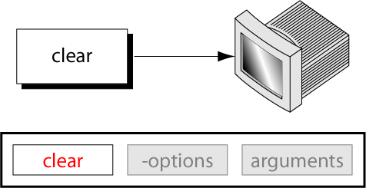
The clear Command

Slide 18
clear command is used to remove all previous commands and output from consoles and terminal windows in Unix-like operating systems
Clear is one of the very few commands in Unix-like operating systems that accepts neither options nor arguments (i.e., input files).
clear

Slide 19
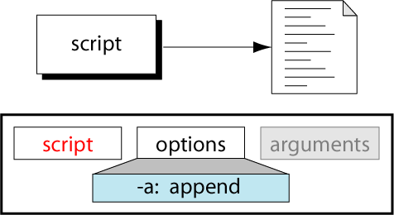
The script Command

Slide 20
It saves a session of your terminal
In spite of saving each command per line in a text file, script makes a typescript of everything that happens on the terminal. Screencasting tools to a desktop session(GUI) is what script is to a terminal.
script
Script started, file is typescript
[shredder12]$ cd
[shredder12]$ ls
file1 file2 file3
[shredder12]$ exit
exit
Script done, file is typescript

Slide 21
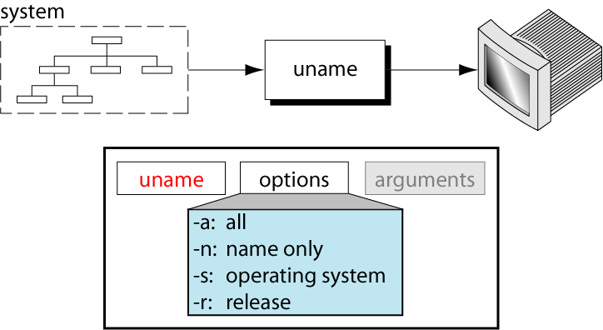
The uname Command

Slide 22
Sometimes it is required to quickly determine details like kernel name, version, hostname, etc of the Unux you are using
When the ‘uname’ command is run without any option then it prints just the kernel name
$uname
Linux

